Slide 1
OBSTACLE AVOIDANCE BASED ON ARTIFICIAL INTELLIGENCE
Project Presentation
Students: Ranjan Singh 19mim10054
Sayan kumar Hatai 19mim10006
Virat Srivastava 19mim10012
Ayush Das 19mim10021
submitted to Nilamadhab Mishra
Computer Science Department
VIT Bhopal University
‹#›
Notes:
‹#›

Slide 2
Introduction
Statement: The main objective is to learn to avoid obstacles in “N” Episodes and learn the optimal action. In this case, let's assume we need our Robot to learn optimal action as 'Right'.
Reinforcement Algorithm Used: Q learning
‹#›

Slide 3
Proposed work and methodology
1. STATE: -This is the situation in which is the robot .here for a basic Obstacle avoiding robot, there are in total 2 states ……1st state is when there is no obstacle close to it and 2ndstate in which there is an obstacle in front of it.(when I wrote the code I assumed 10 different states can be in which expected the same action. The reason I did this to illustrate a more complex environment.)
‹#›
Notes:
‹#›

Slide 4
Proposed work and methodology
2. ACTION: In a particular State the robot performs a particular action. There are 4 actions which the robot can perform in 2nd state: “FORWARD”, “BACKWARD”, “LEFT”, “STOP”. In 1st state, the robot can perform 4 actions but to make things easier I have assumed that robot can perform only one action which is “FORWARD”( This is because its lame to consider actions such as LEFT or BACKWARD when there are no obstacles nearby.
‹#›
Notes:
‹#›

Slide 5
Proposed work and methodology
3. NEXT STATE: This is the state robot gets in when it performs a particular “ACTION” in its current “STATE”. In obstacle avoiding the robot case, the NEXT STATE can be either a “CRASHED” state or a “SURVIVED” State. (Here SURVIVE state is same as the starting state that robot is in when its episode starts.
‹#›

Slide 6
Proposed work and methodology
4. TERMINAL STATE: This is the last state in which the robot can be in. For obstacle Avoiding Robot, this state doesn’t exist as we don’t have any terminal state and want to keep our Robot learning forever.
‹#›
Notes:
‹#›

Slide 7
Proposed work and methodology
5. ENVIRONMENT: This can also be assumed or considered as the world for the Robot. For example, we humans live on earth so basically earth is our environment.
‹#›

Slide 8
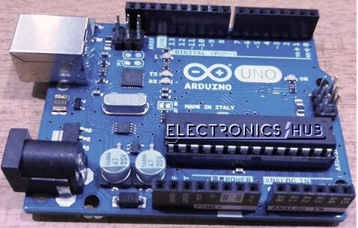
Hardware & software requirements
Arduion pro mini328 5v / 16 MHz
‹#›
Notes:
‹#›

Slide 9
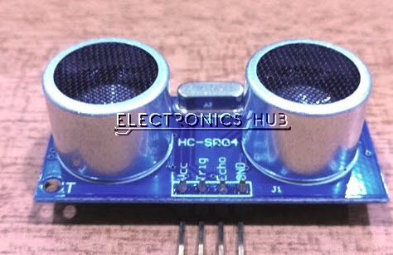
Hardware & software requirements
2. Ultrasonic sensor – HC – SR04
‹#›
Notes:
‹#›

Slide 10
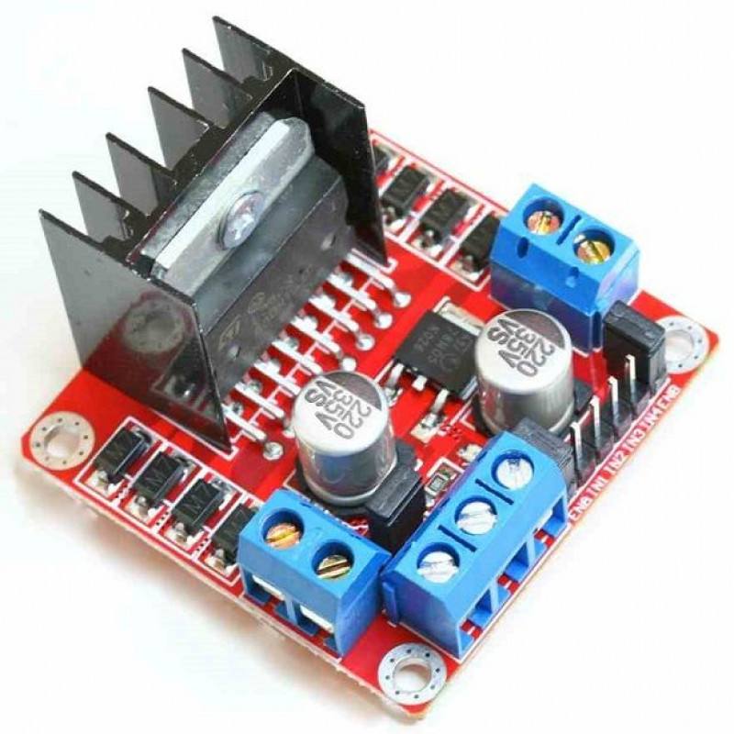
Hardware & software requirements
3. Dual H-Bridgemotor Driver L298
‹#›
Notes:
‹#›

Slide 11
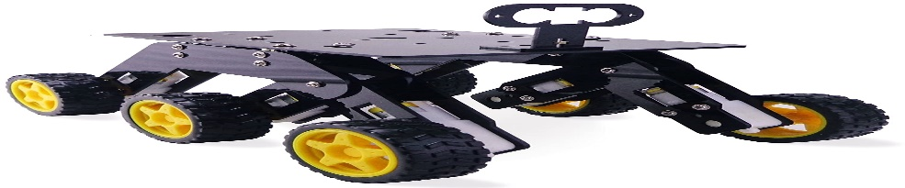
Hardware & software requirements
4. DC Motor & Wheels
‹#›

Slide 12
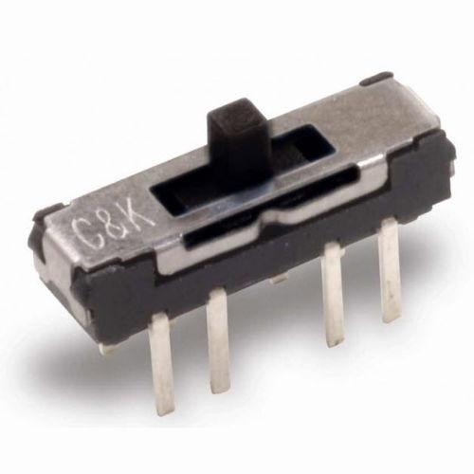
Hardware & software requirements
5. C & K Switches JS Series Switches
‹#›

Slide 13
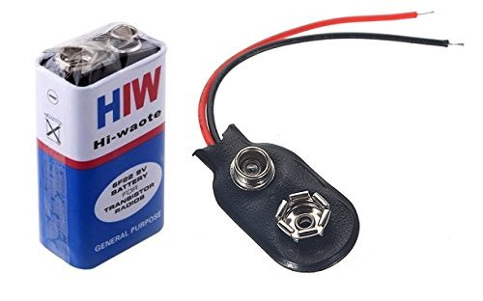
Hardware & software requirements
6 . PCBWay customPCB
7. 9V Battery & Battery Clip
‹#›

Slide 14
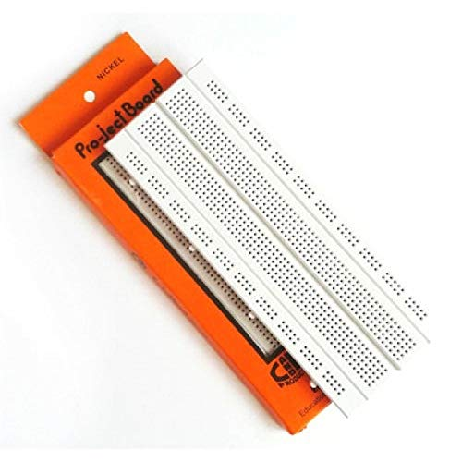
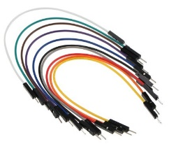
Hardware & software requirements
8. BreadBoard & Jumper Wires
‹#›

Slide 15
Hardware & software requirements
We will be used Arduino IDE
The Arduino Integrated Development Environment is a cross-platform application (for Windows, macOS, Linux) that is written in functions from C and C++. It is used to write and upload programs to Arduino compatible boards, but also, with the help of third-party cores, other vendor development boards.
‹#›

Slide 16
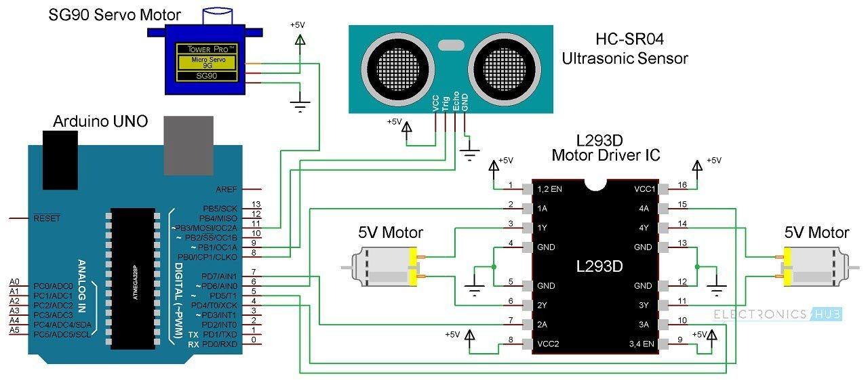
Overall system architecture diagram
‹#›

Slide 17
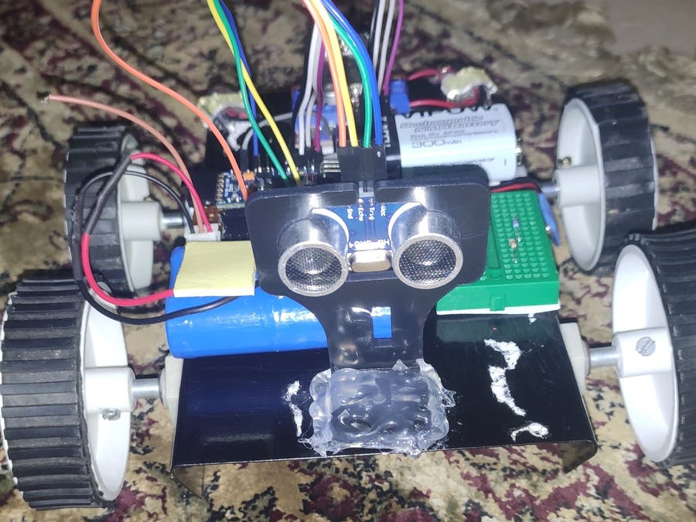
Overall system architecture diagram
‹#›

Slide 18
NOVELTY OF THE PROJECT:
This project presents a novel online unsupervised vision system for obstacle detection in the field environments which detects many obstacles pathological to appearance or structure only obstacle detection systems. Robust obstacle detection in field environments is challenging as it is infeasible to train on all possible obstacles in all conditions, and many obstacles are camouflaged in their appearance or structure. The proposed system combines novelty in structure and appearance cues to detect obstacles, can adapt over time to changes in the environment.
‹#›

Slide 19
REAL TIME USAGE: Integration of local incremental planning and potential field is proposed for a motion planning of the car-like robot in this research so that obstacle avoidance and goal seeking could be achieved in real time. Both attractive and repulsive forces are function of both relative position and velocity between robot-obstacle and robot-target. The motion planning of the car-like robot has been demonstrated using this new local incremental planning when the unknown and dynamics environment contains either fixed multiple obstacles or moving obstacles. Results, demonstrated in Matlab simulation, reveal that the car-like robot can reach the target point and avoid moving obstacles at the same time, which could be implemented for a real car robot in near future.
‹#›

Slide 20
CONCLUSION:
This project presents a new method of vision-based surveillance robot with obstacles avoidance capabilities for general purpose robot in indoor environments. Algorithms of neural network for obstacle avoidance were implemented in the robot. Experimental results with various positions of obstacle show the ability of robot to avoid it and have shown a good performance. The robot is also able to recognize victims in front of the robot. The sensor system is very cheap because it only uses 3 distance sensors.
‹#›

Slide 21
THANK YOU
‹#›

Slide 22
PART 2
‹#›

Slide 23
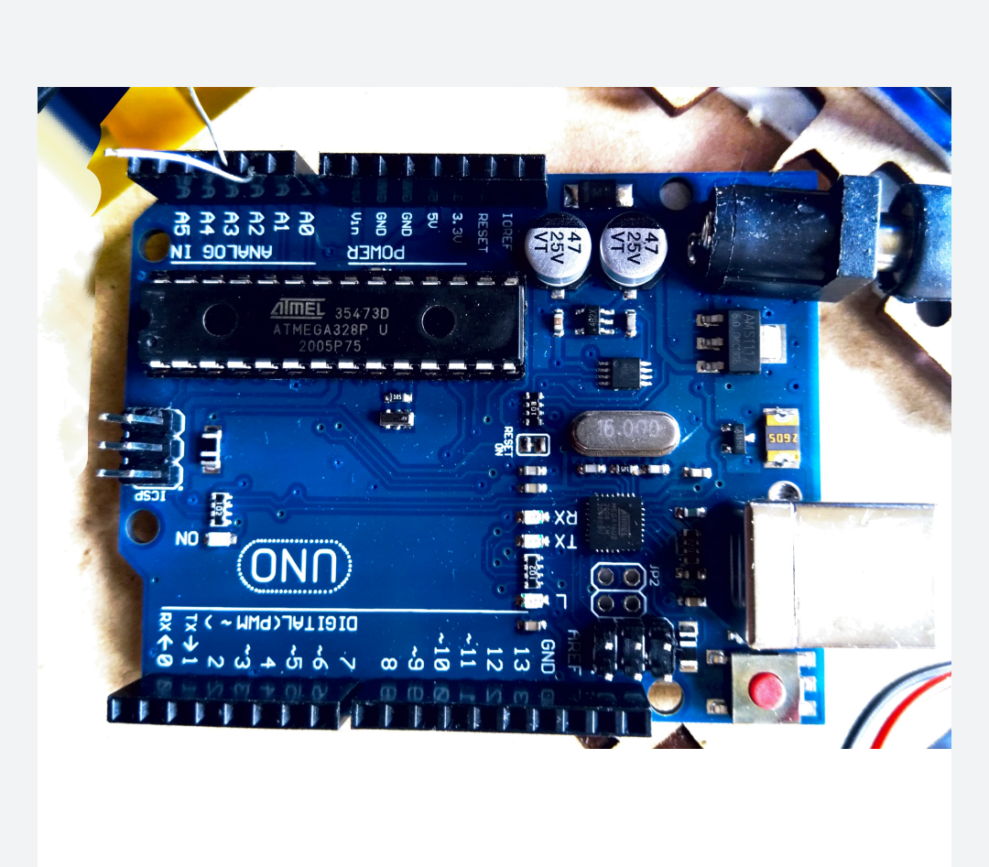
Module description & Module work flow explanation
‹#›

Slide 24
Module description & Module work flow explanation
Ardionu Board pin no VCC is connected to the vcc pin of the Bridge board .
Ardionu Board pin no GND is connected to the GND pin of Bridg board .
Ardionu Board all Digital pin is connected to the all digital pin of bridge Board .
Ardionu Board all analog pin is connected to the all analog pin of bridge Board .
According to the digram .
‹#›

Slide 25
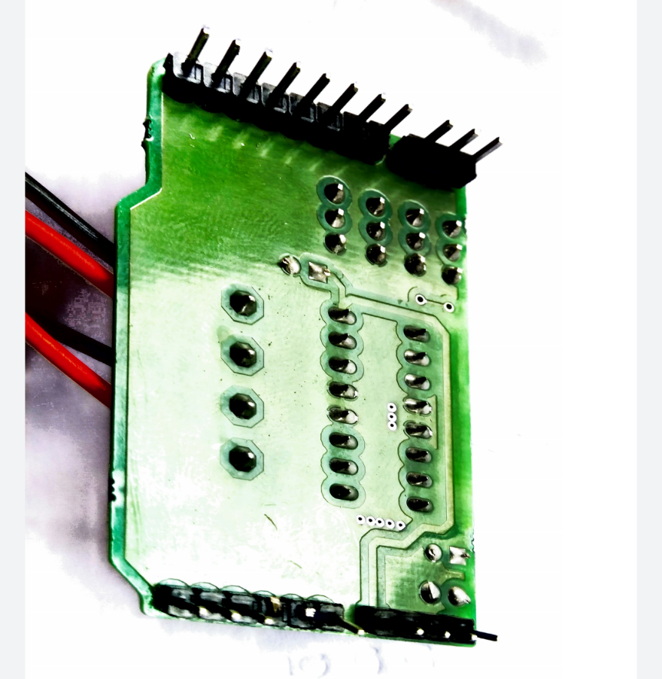
Module description & Module work flow explanation
This is Arduino Board
This is H Moter Bridge
‹#›

Slide 26
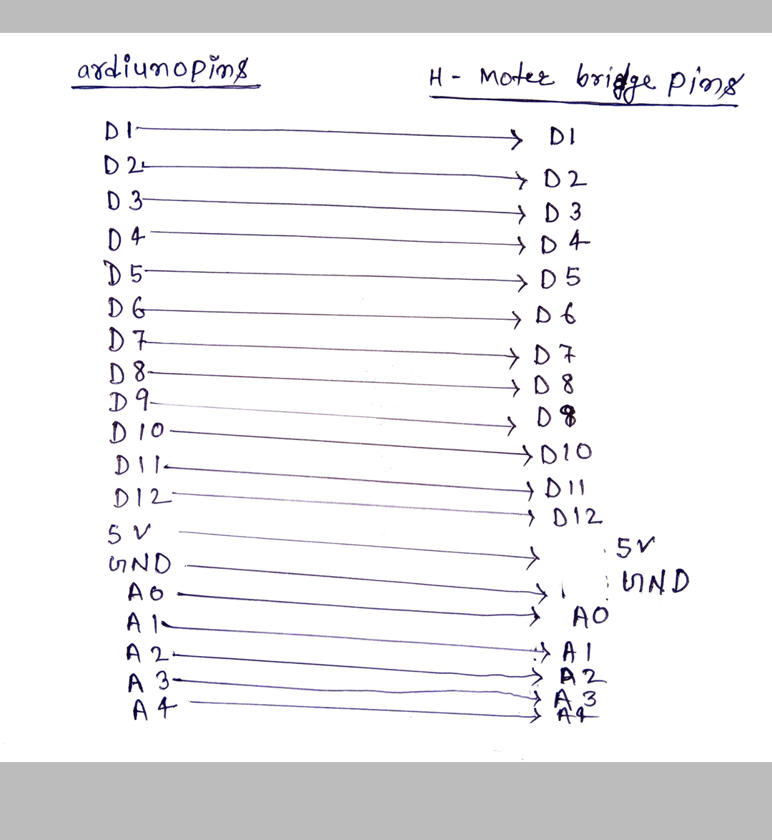
Module description & Module work flow explanation
All pins of Arduino board and moter bridge are attached according to this digram.
‹#›

Slide 27
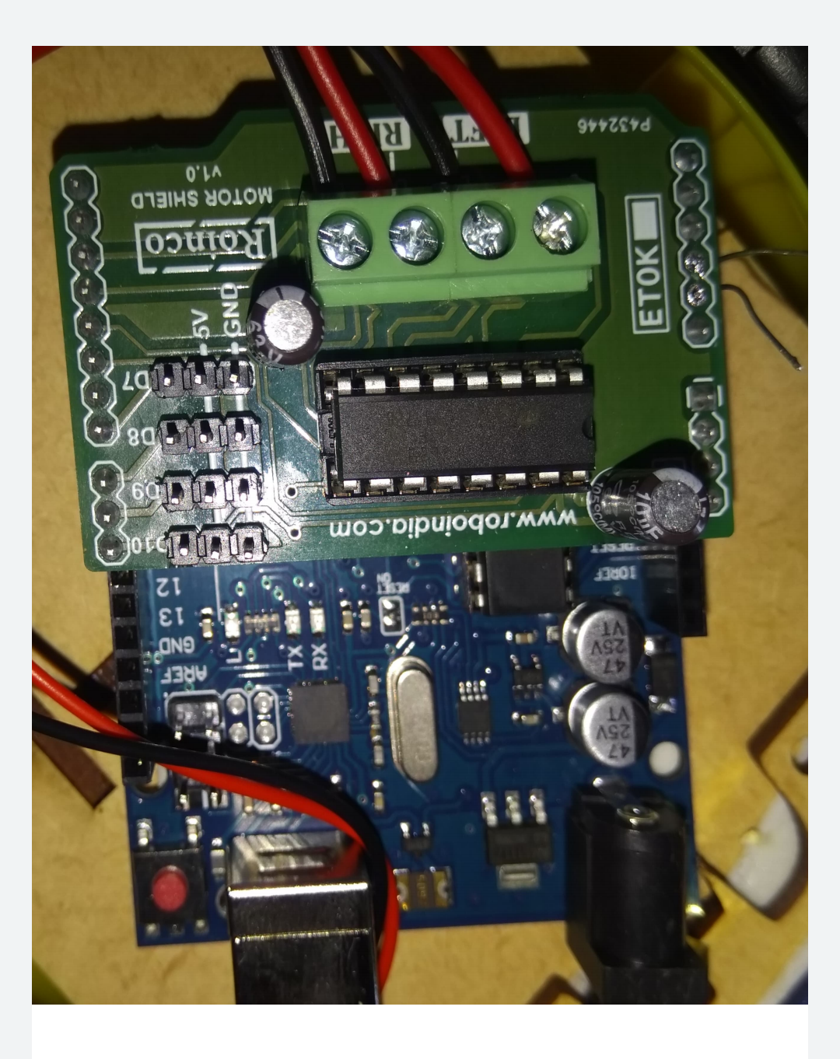
Module description & Module work flow explanation
Final diagram will look something like this
‹#›

Slide 28
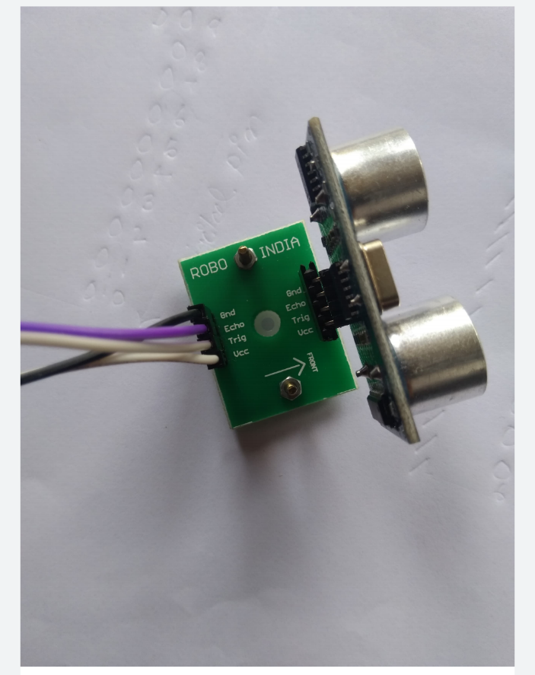
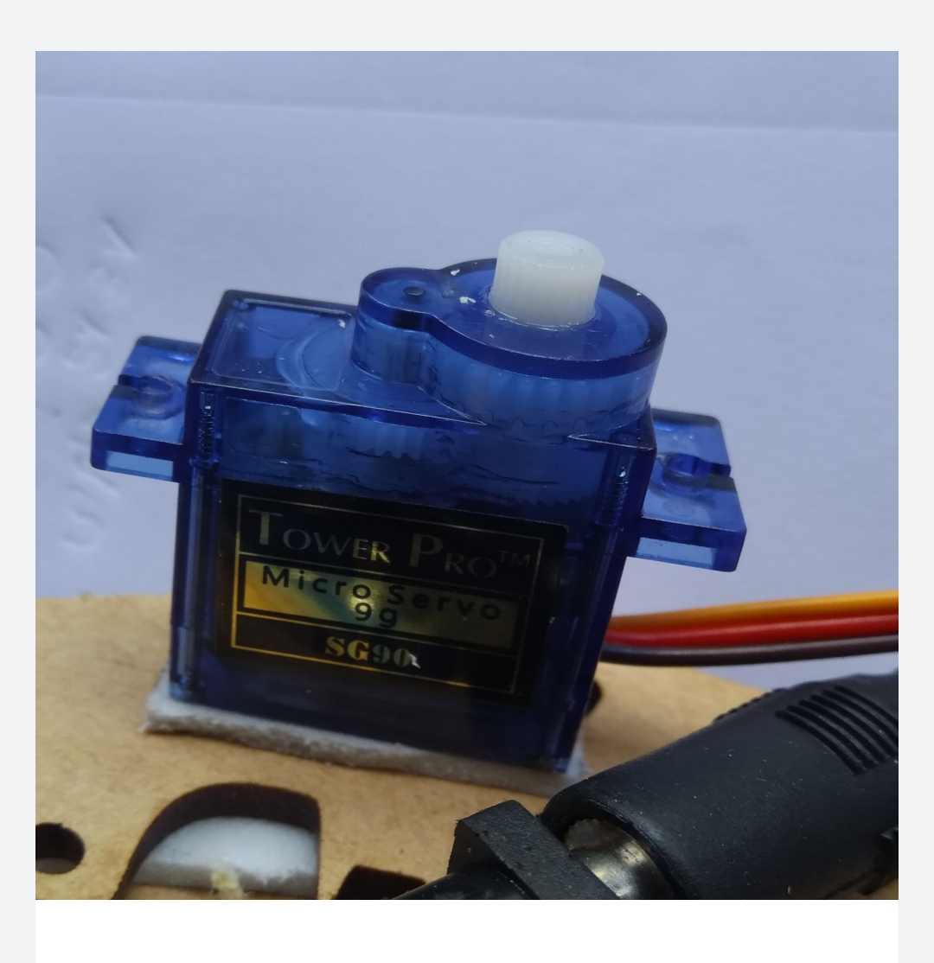
Module description & Module work flow explanation
Servo Moter
Ultrasonic sensor – HC – SR04
‹#›

Slide 29
Module description & Module work flow explanation
In Ultrasonic sensor has basically four pins
VCC pin, Triger pin, Echo pin and GND pin.
In servo Moter has basically three pins
VCC pin, GND pin, and signal pin .
‹#›

Slide 30
Module description & Module work flow explanation
Connection between Ultrasonic sensor and bridge Board.
Ultrasonic sensor pin GND is connected to pin GND of Bridge Board.
Ultrasonic sensor pin VCC is connected to pin VCC of Bridge Board.
Ultrasonic sensor pin Trigar is connected to pin A1 of Bridge Board.
Ultrasonic sensor pin Echo is connected to pin Echo of Bridge Board.
‹#›

Slide 31
Module description & Module work flow explanation
Connection between Servo Moter and Bridge board.
Servo Moter pin GND is connected to pin GND of Bridge Board.
Servo Moter pin VCC is connected to pin VCC of Bridge Board.
Servo Moter pin signal is connected to pin no D10 of Bridge Board.
‹#›

Slide 32
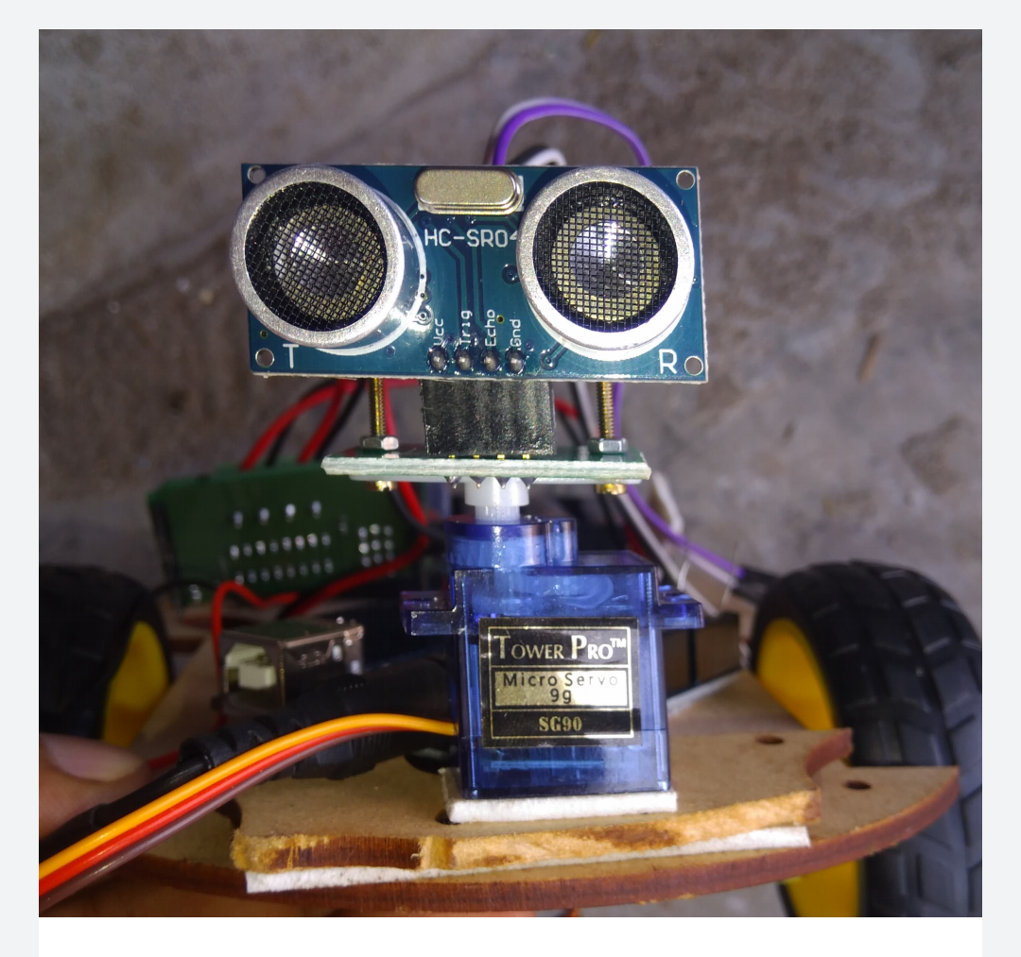
Module description & Module work flow explanation
Ultrasonic sensor attached on the servo moter
‹#›

Slide 33
Module description & Module work flow explanation Connection between left, right Moter and Bridge Board .
Left Moter
Right Moter
Left Wheel Moter pin no 1 is connected to the pin no D2 of the Bridge Board.
Left Wheel Moter pin no 2 is connected to the pin no D3 of the Bridge Board.
Right Wheel Moter pin no 1 is connected to the pin no D4 of the Bridge Board.
Wheel Moter pin no 2 is connected to the pin no D5 of the Bridge Board.
‹#›

Slide 34
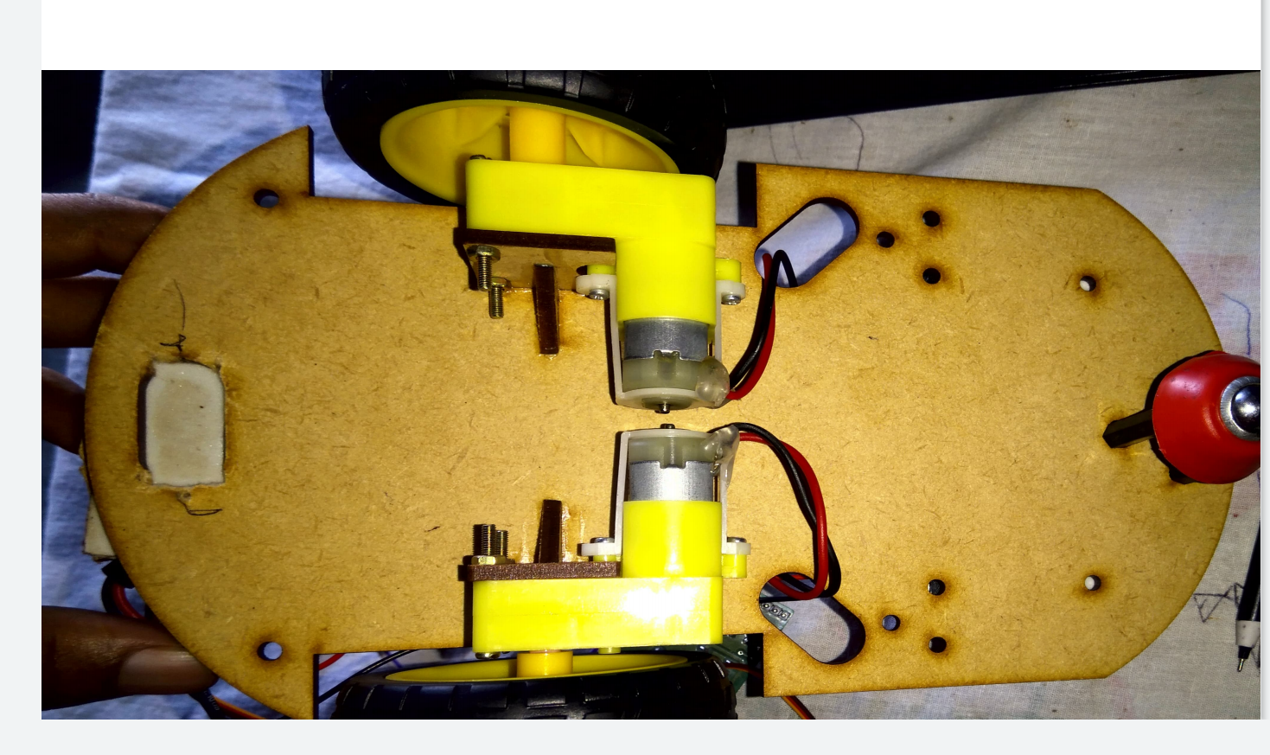
Module description & Module work flow explanation
All wheel moter is attached like this way
‹#›

Slide 35
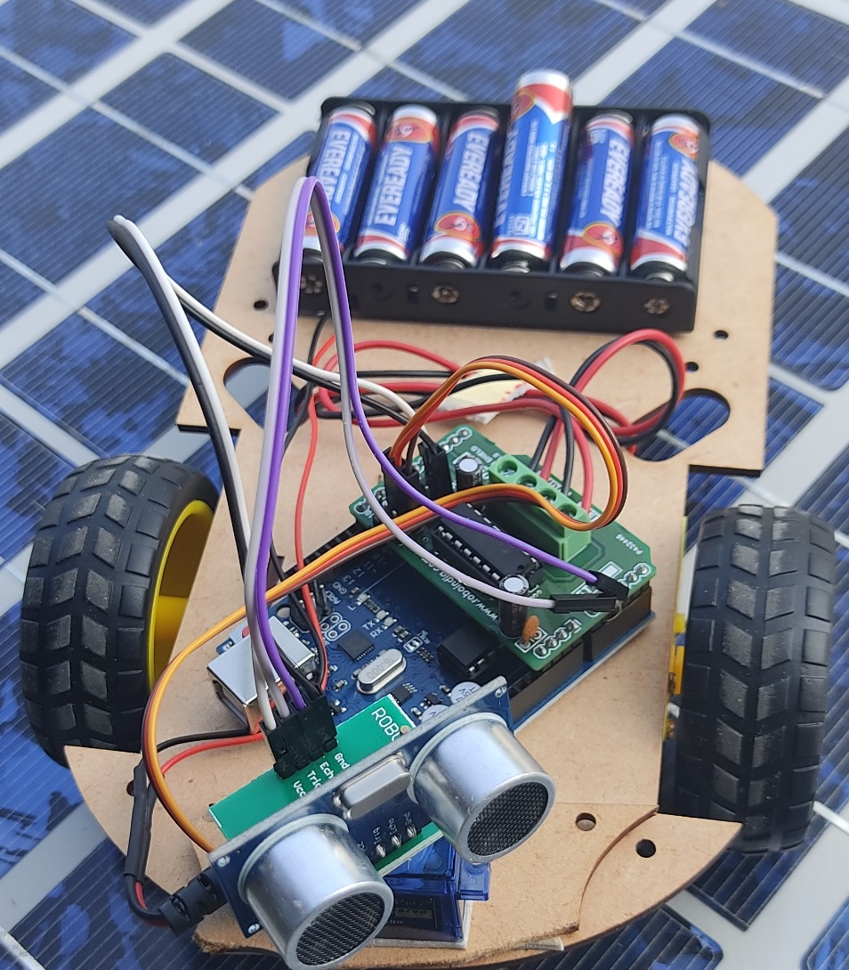
Module description & Module work flow explanation
‹#›

Slide 36
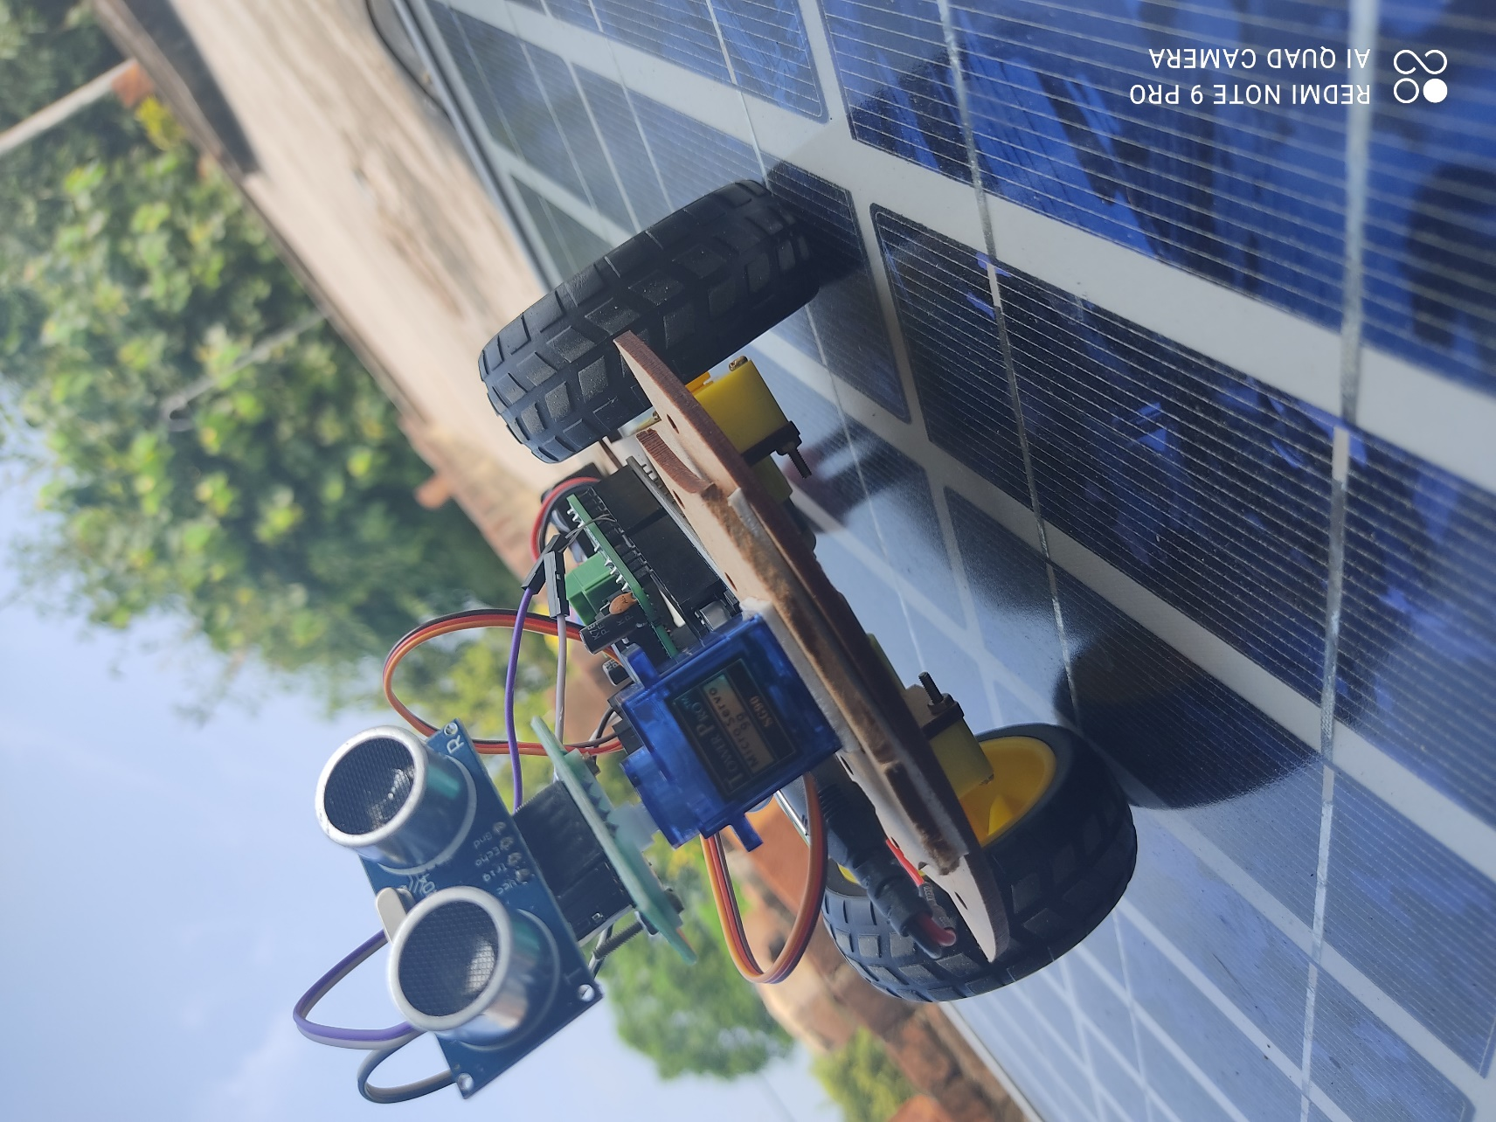
Module description & Module work flow explanation
‹#›

Slide 37
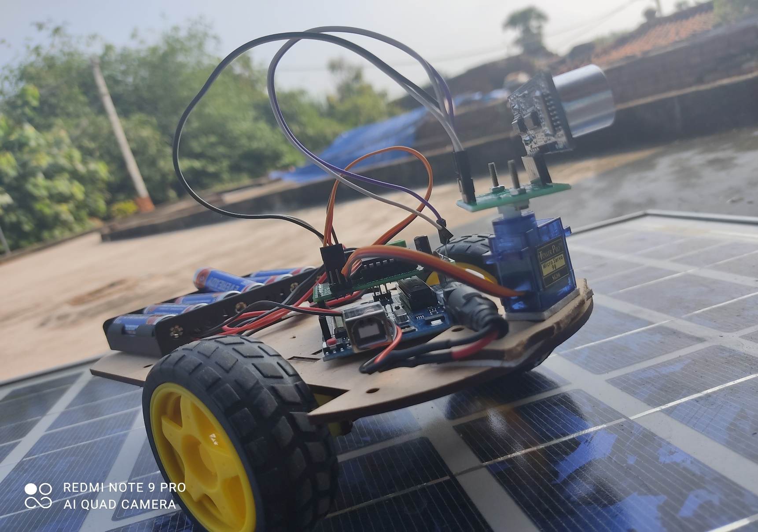
Module description & Module work flow explanation
‹#›

Slide 38
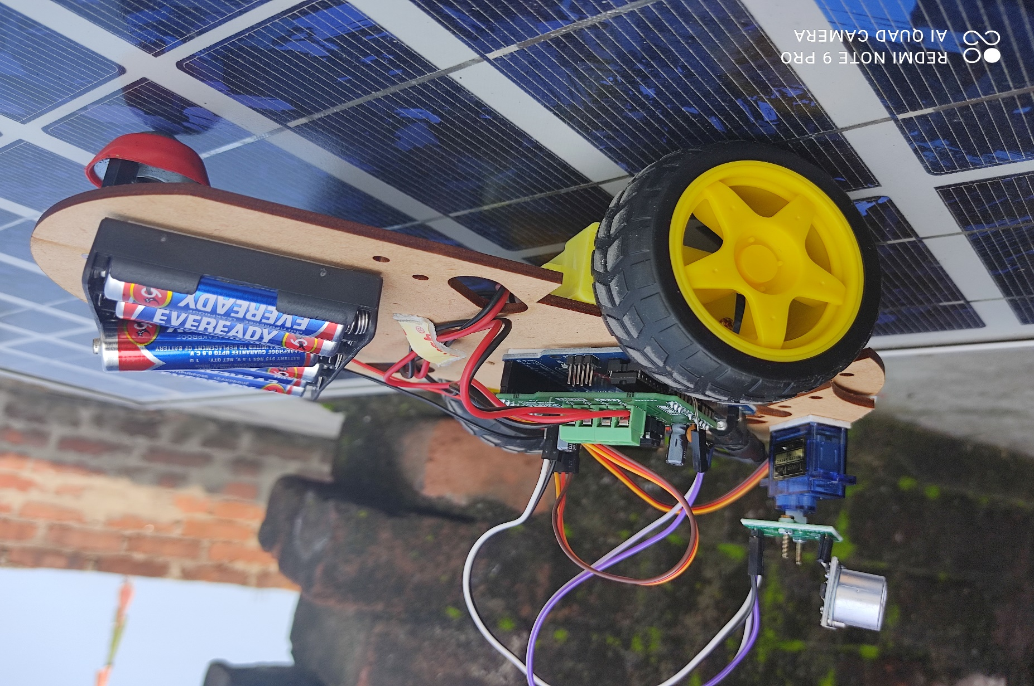
Module description & Module work flow explanation
‹#›

Slide 39
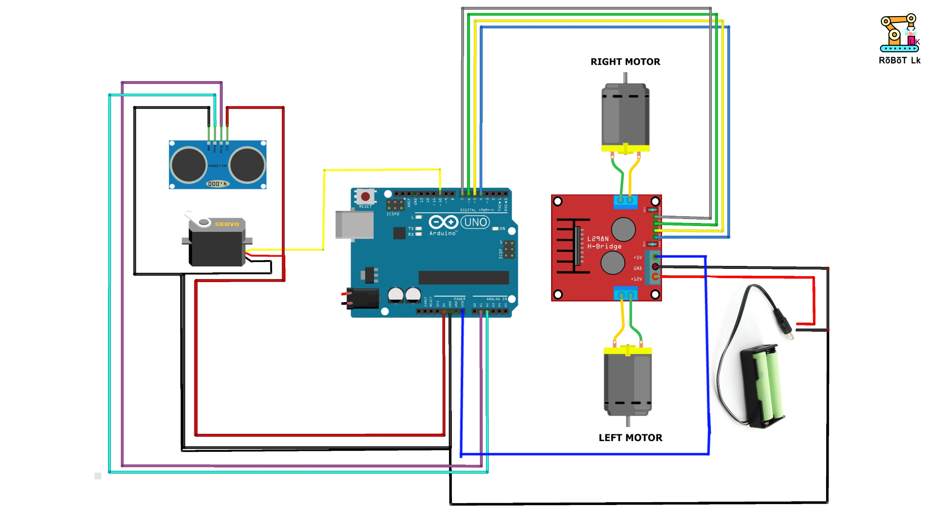
Module description & Module work flow explanation
All setup according to this digram
‹#›

Slide 40
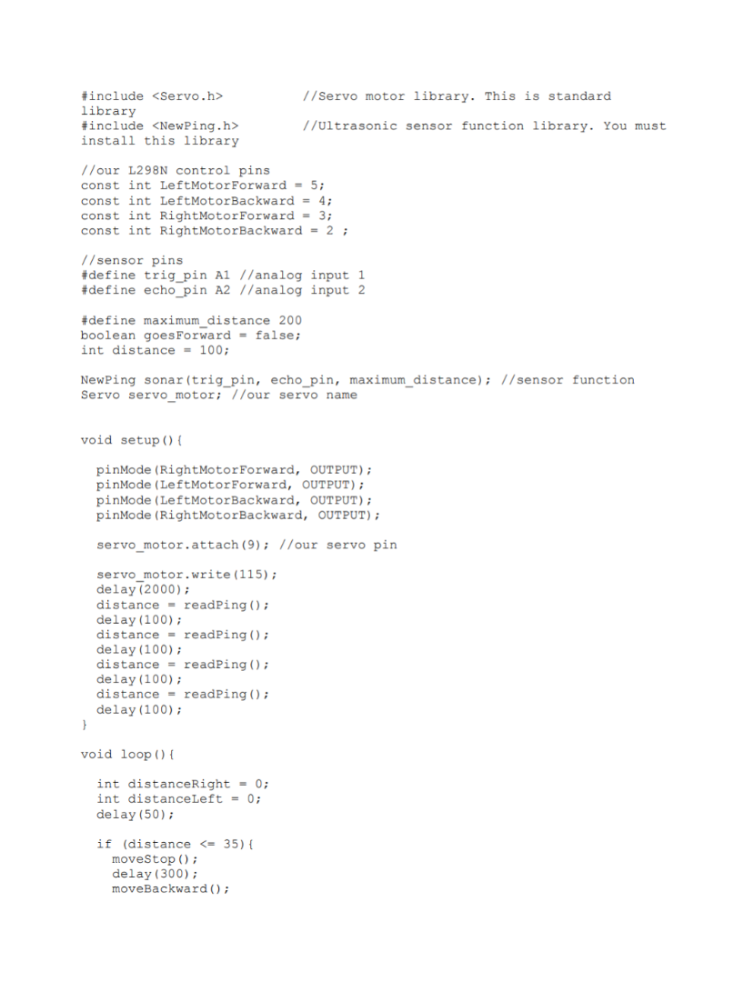
Implementation and coding.
‹#›

Slide 41
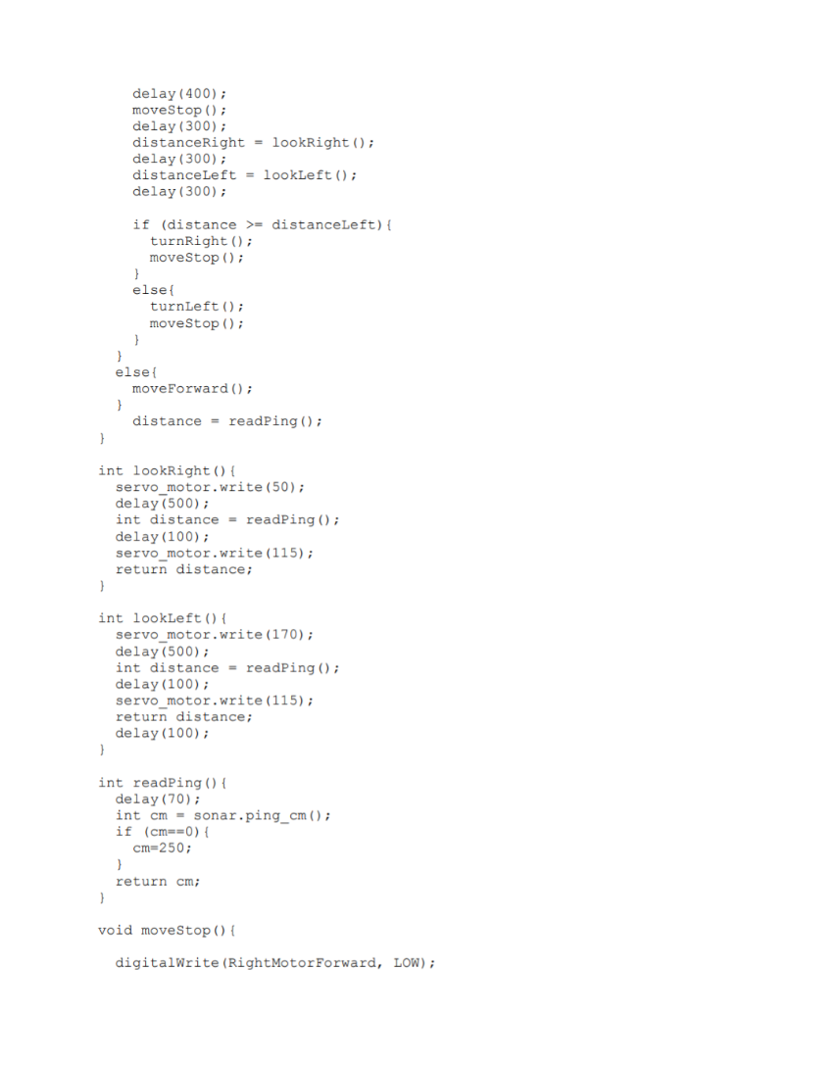
Implementation and coding.
‹#›

Slide 42
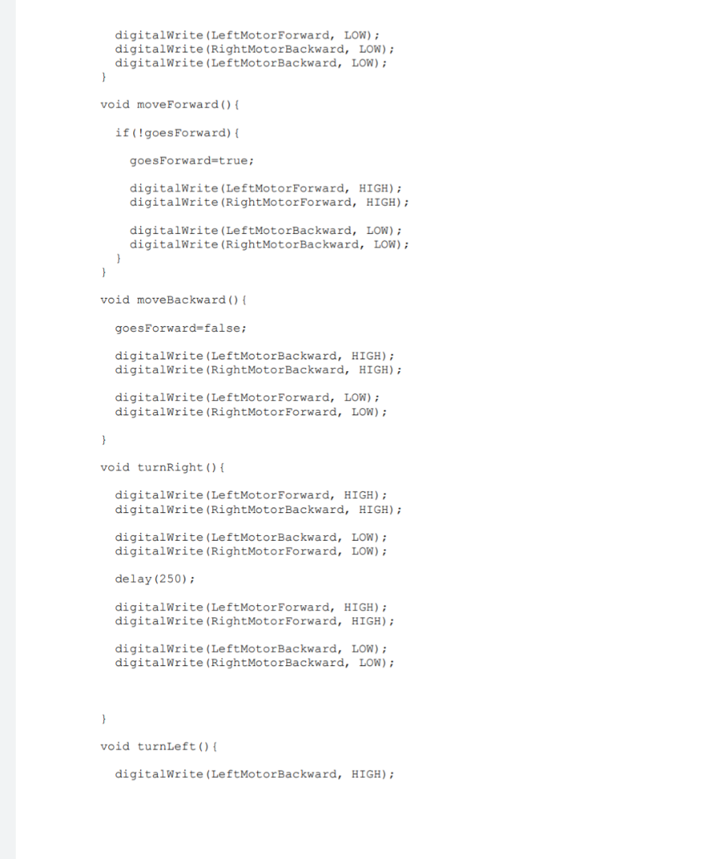
Implementation and coding.
‹#›

Slide 43
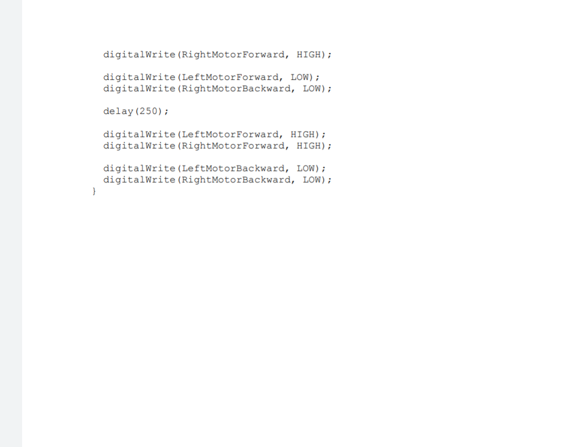
Implementation and coding.
‹#›

Slide 44
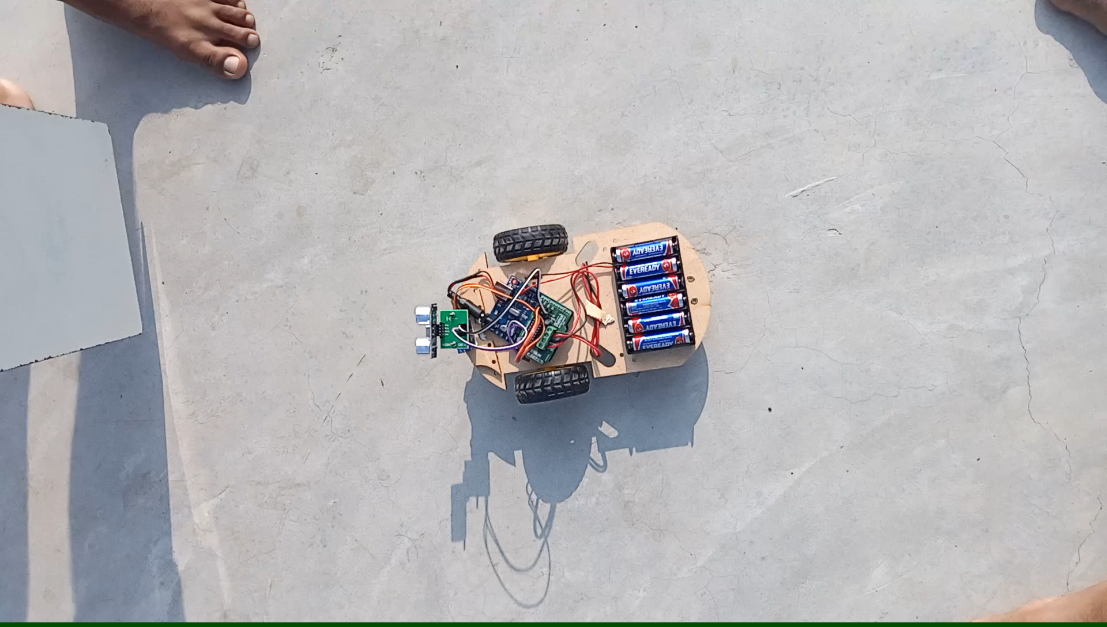
Demo video.
‹#›

Slide 45

‹#›

